Slide 1

RAMKOLEK
DOCUMENT MANAGEMENT SYSTEM FOR PROJECT DOCUMENTATION PAPERS ​
DASALGORITHM | 2024

Slide 2
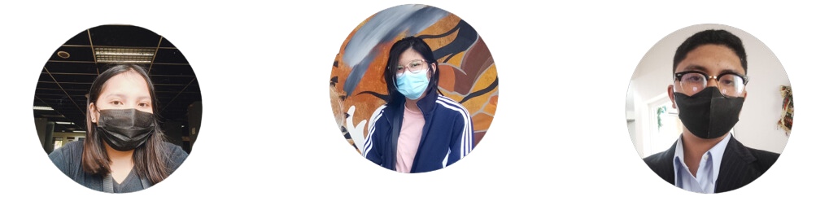
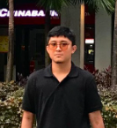
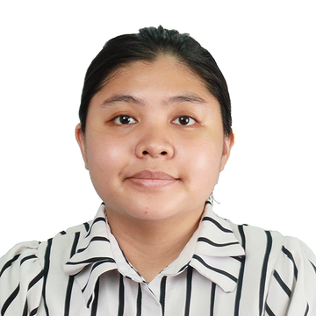
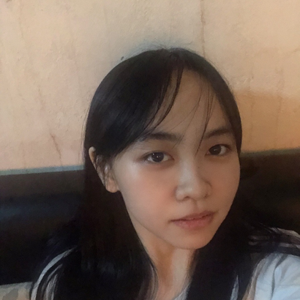
OUR TEAM
2
Leila Arcega
Scrum Master
Developer
Jeb Cajayon
Project Manager
Product Owner
Jonlord Mirando
Project Manager
Product Owner
Raina Terania
Developer
Lyka Tesorero
Developer
Daniella Soquiat
Developer
Jeb Cajayon

Slide 3

CLIENT
3
Asia Pacific College
Jeb Cajayon

Slide 4


PROJECT CONTEXT
4
Current Process
Microsoft Teams
Microsoft Outlook
Jeb Cajayon

Slide 5
STATEMENT OF THE PROBLEM
5
Main Problem
Lack of an organized platform for project paper submissions.​
Specific Problem
The current process for project submissions along with the proofreading request form makes it difficult to keep track of files and updates because submission is done through email and MS Teams.
For the PBL professors and PBL coordinator in the current system it needs them to manually create reports and manually gathered data about a group’s project.
Jeb Cajayon
Notes:
Icon or illustration would be good to use for this​

Slide 6
OBJECTIVES
6
Main Objective
Develop a document management system for APC students and faculty.​
Specific Objective
Provide a web application for seamless document submission and proofreading requests. Incorporate a status tracking system to monitor updates and progress. ​
Automate report generation and data gathering for submission summaries.​
Jeb Cajayon
Notes:
Icon or illustration would be good to use for this​

Slide 7
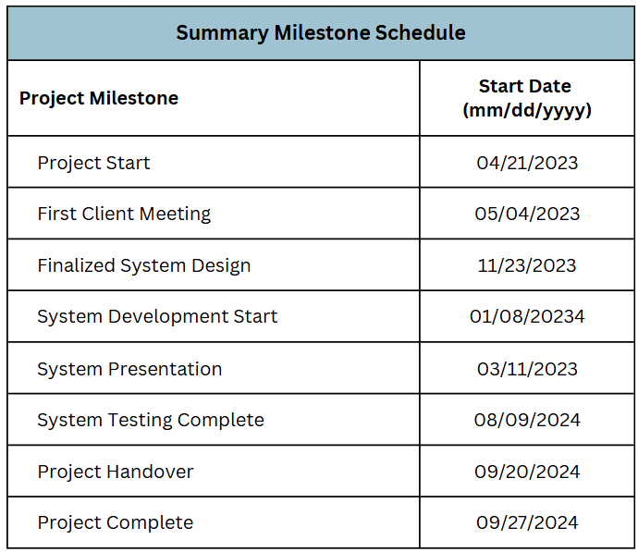
PROJECT MILESTONES
7
Daniella Soquiat

Slide 8
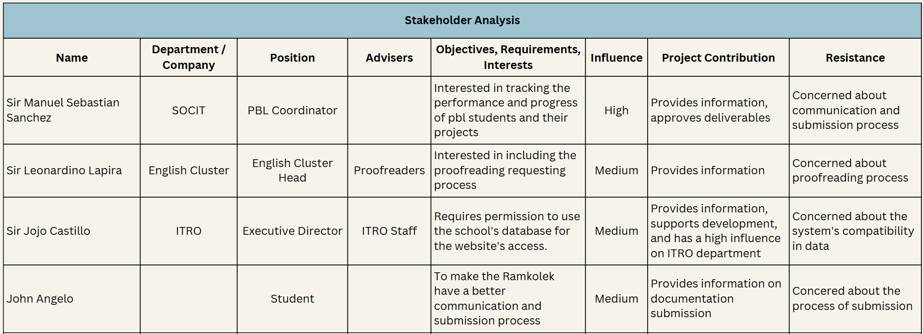
STAKEHOLDER ANALYSIS
(cont.)
9
Jonlord Mirando

Slide 9
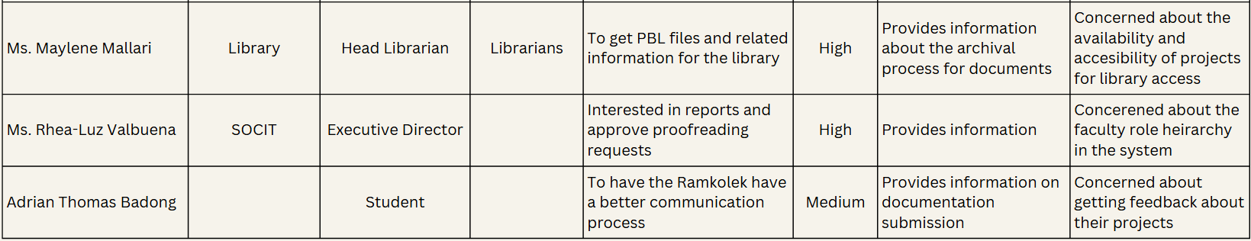
STAKEHOLDER ANALYSIS
(cont.)
10
Jeb Cajayon

Slide 10
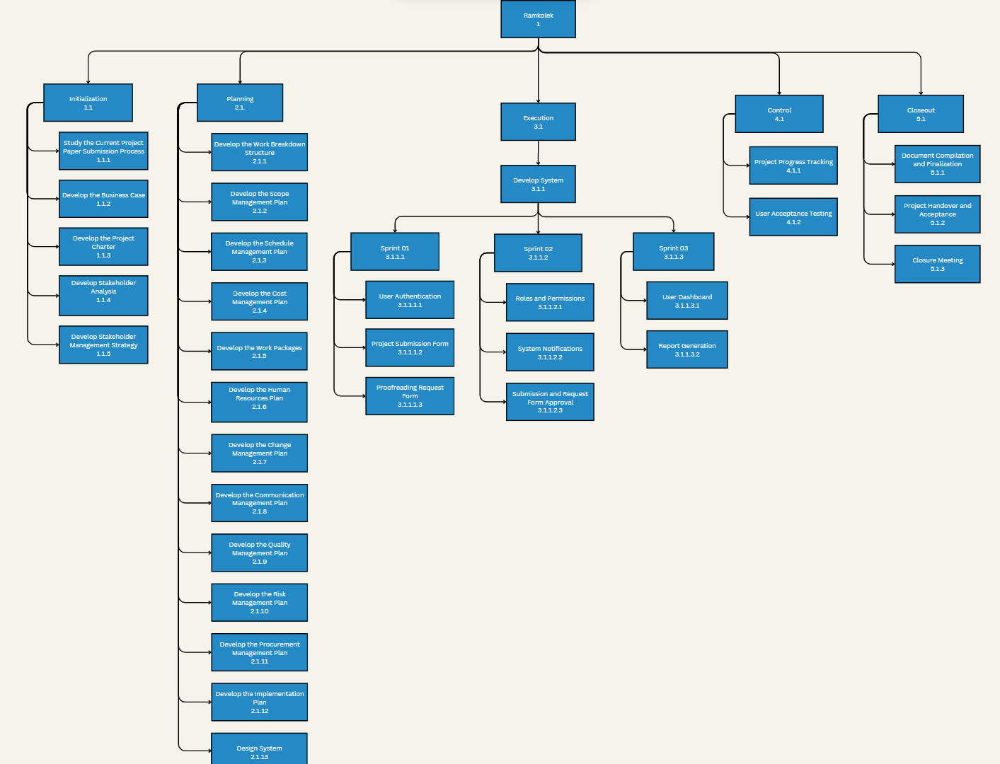
WBS
11
Leila Arcega

Slide 11
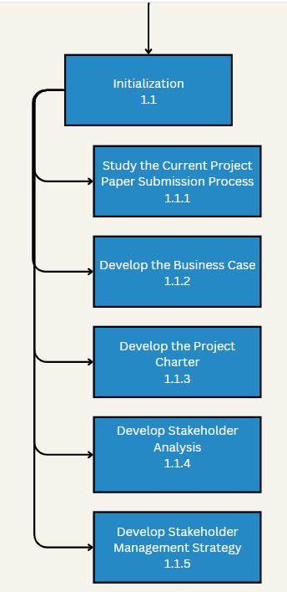
WBS
(cont.)
12
1.1 Initialization
Leila Arcega

Slide 12
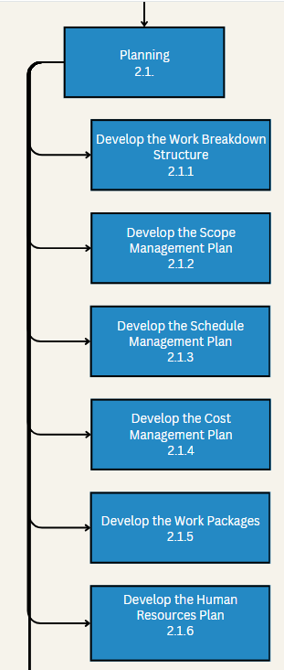
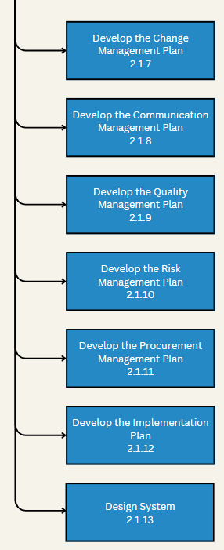
WBS
(cont.)
13
2.1 Planning
Leila Arcega

Slide 13
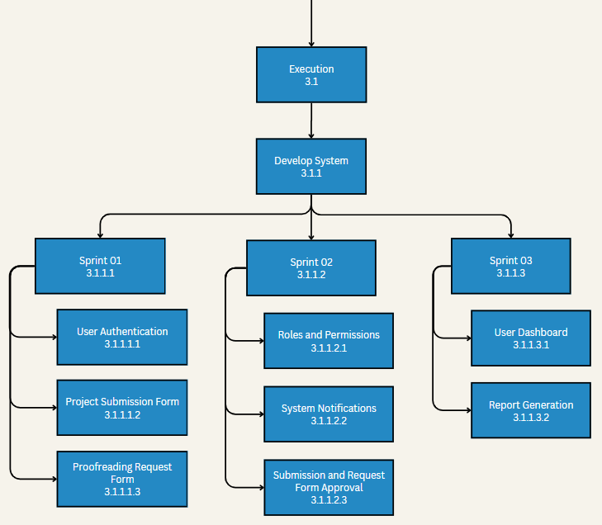
WBS
(cont.)
14
3.1 Execution
Leila Arcega

Slide 14
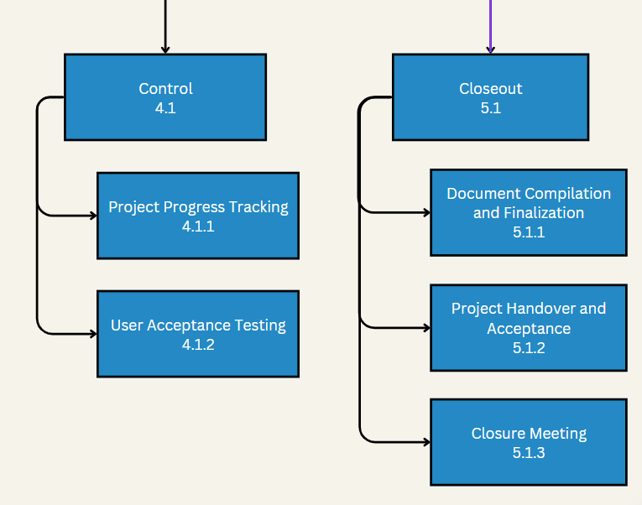
WBS
(cont.)
15
4.1 Control
Leila Arcega

Slide 15
WBS
(cont.)
16
5.1 Closeout
Leila Arcega

Slide 16
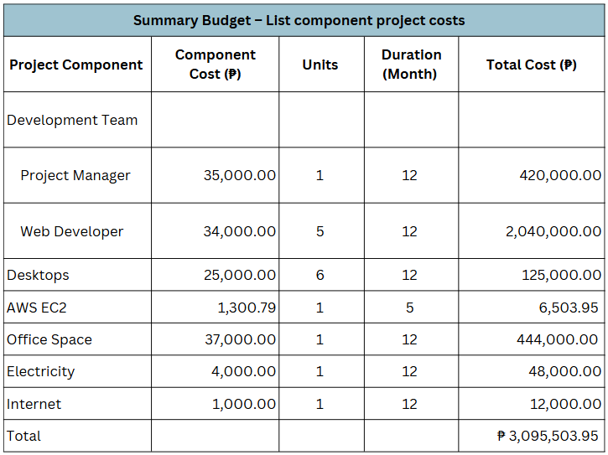
PROJECT COST
17
1
Daniella Soquiat

Slide 17
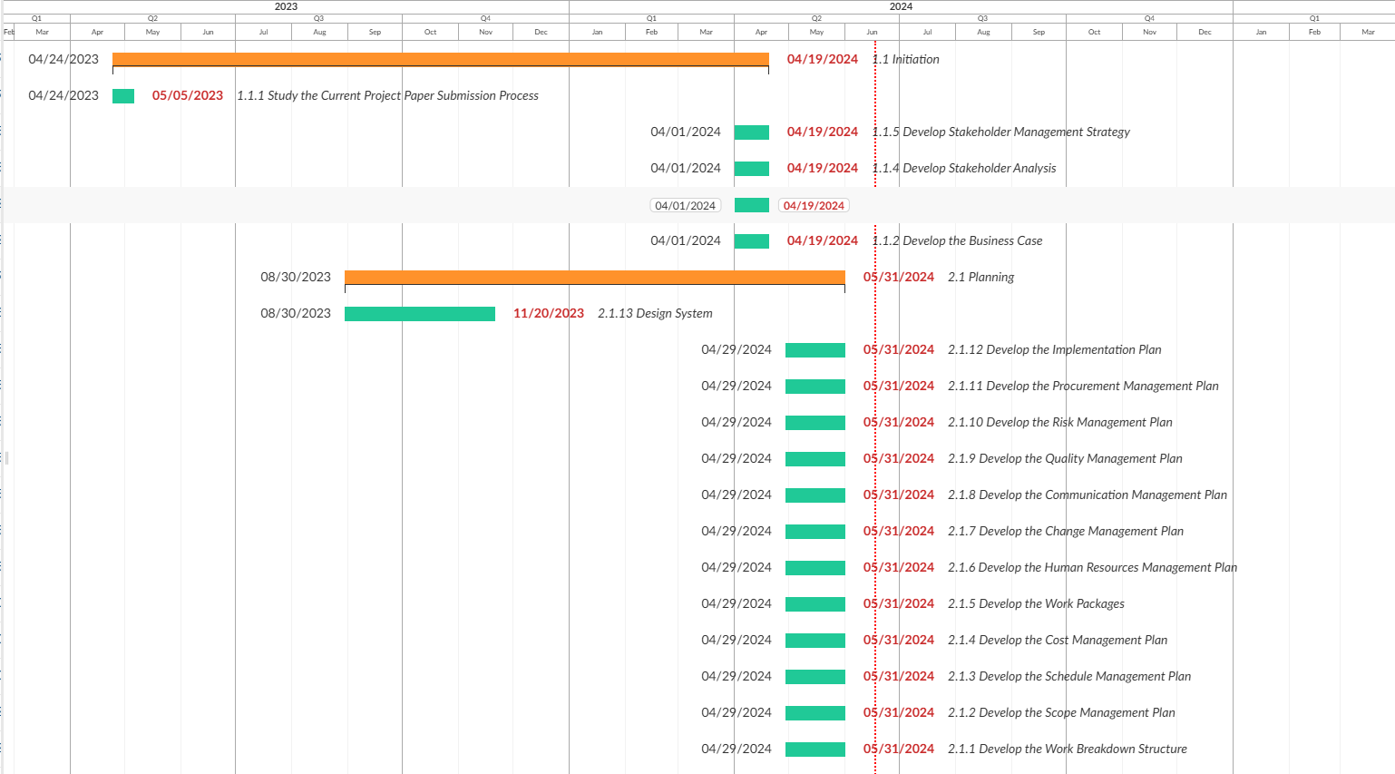
GANTT CHART
18
Lyka Tesorero

Slide 18
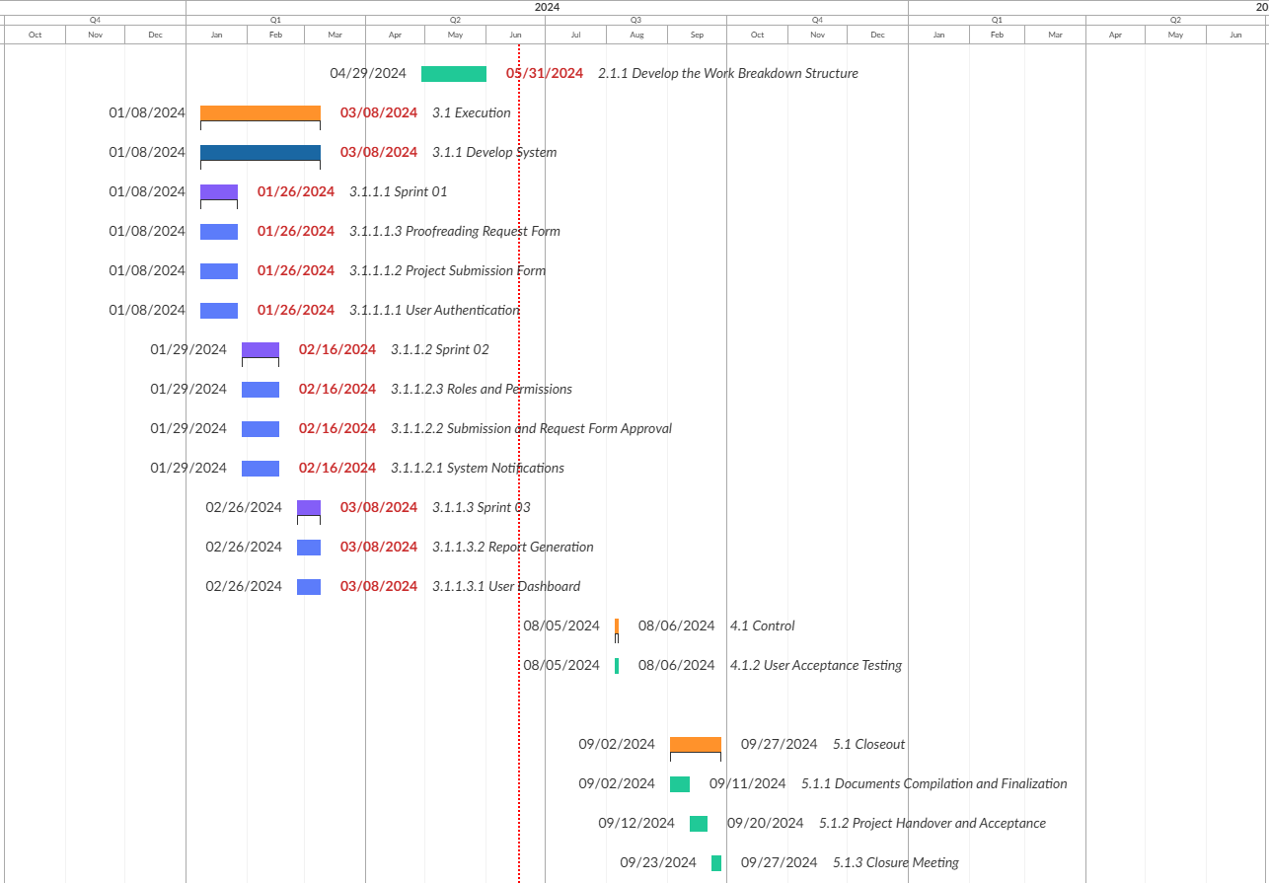
GANTT CHART
(cont.)
19
Lyka Tesorero

Slide 19
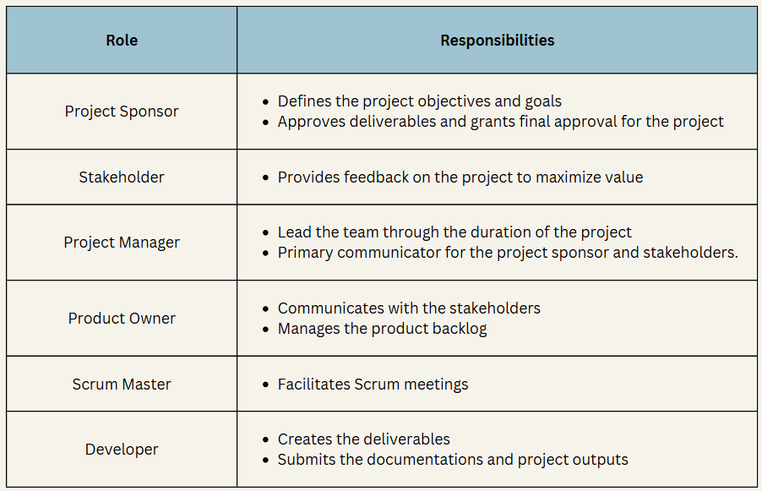
ROLES AND RESPONSIBILITIES
20
Raina Terania

Slide 20
SCOPE MANAGEMENT PLAN
21
5 Step Process of Project Scope Management
1.Collect requirements- aggregate information from stakeholders involved in Ramkolek
2.Define scope- analyze and use the requirements to define the scope
3.Create WBS- breakdown work packages into smaller task containing level codes
4.Verify scope- a formal approval is defined on the scope
5.Control scope- monitoring, dictating the project, and lead the scope baseline
Raina Terania

Slide 21
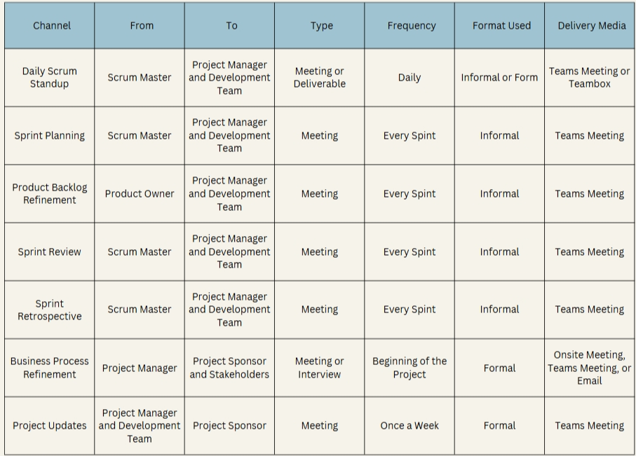
COMMUNICATIONS MATRIX
(cont.)
23
Leila Arcega

Slide 22
COMMUNICATIONS MATRIX
(cont.)
24
Leila Arcega

Slide 23
COMMUNICATIONS MATRIX
(cont.)
25
Leila Arcega

Slide 24
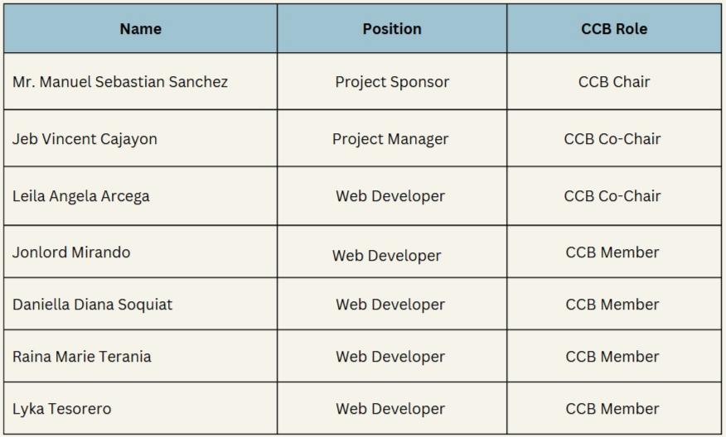
CHANGE CONTROL BOARD
26
Jonlord Mirando

Slide 25
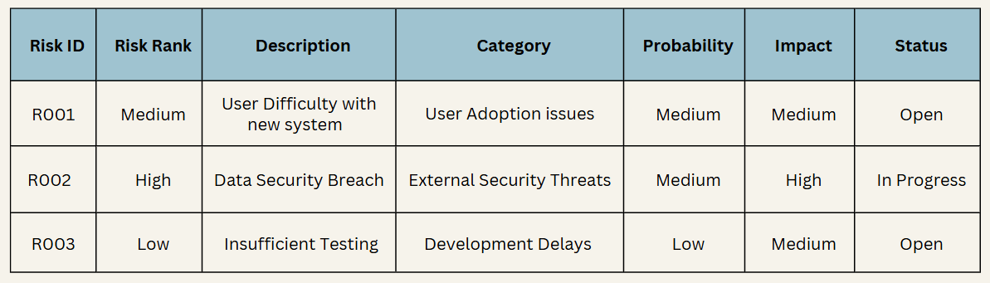
RISK REGISTER
27
Jonlord Mirando

Slide 26
CONTRIBUTION
28
Leila Arcega
Jeb Cajayon
Jonlord Mirando
Stakeholder Management Plan​
Risk Management Plan
Change Management Plan
Work Packages
Business Case​
Project Charter​
Stakeholder Management Plan​
Stakeholder Analysis​
Work Breakdown Structure​
Schedule Management Plan​
Implementation Plan​
Communication Management Plan
Change Management Plan​
Consolidated Project Management Plan​
OpenProject​
Jira
PPT
Github Wiki
Stakeholder Management Plan​
Stakeholder Analysis​
Github Wiki
Jira
Open Project

Slide 27
CONTRIBUTION
(cont.)
29
Daniella Soquiat
Raina Terania
Lyka Tesorero
Business Case
Stakeholder Analysis
Cost Management Plan
Project Charter
Quality Management PLan
Business Case​
Scope Management​
Human Resource​ Management
Procurement Management​
Cost Management​ plan
PPT
OpenProject
Business Case​
Project Charter​
Stakeholder Management Strategy​
Work Package​
Risk Management Plan​
PPT

